Slide 1
INST314: Final Project
Yazeed Sobahi

Slide 2
Abstract
1- FIFA World Cup is one of the biggest sports events in the world, it attracts millions of attendees and viewers when it occurs every 4 years.
2- With many eyes on the event, there are bound to be some deep analysis and theories surrounding it and the teams involved, and one of these theories is the Champion's curse which suggests that teams that win the world cup, get kicked out of the next World Cup very early in its stages.
3- This research attempts to look into this problem by analyzing World Cup winners’ performance during the World Cup they win, and the matches after.
4- By analyzing their performance, we find out if this "curse" does exist or teams do indeed try their best.
5- We begin by comparing teams' performance in the World Cup they win, and the matches they have in the next 4 years before the next World Cup Championship, we do so by comparing a new variable of score difference that sums the number of goals they scored, and goals they allowed in their own net.
6- Next, we attempt to find out if international matches in any tournament other than FIFA World Cup would be a good predictor of team's performance in the World Cup using linear regression models.
7- Finally, we look into other factors in a football match that may have any impact on team's performance such as the referee supervising the match, the tournament the team participating in, and the stage they are at in the World Cup.
8- We found that teams do maintain their performance that allowed them to win the World Cup in international matches, however their performance there is not a good predictor of World Cup matches. Additionally, we found that there are other factors that have an impact on teams' performance such as tournaments.
9- This research is limited by the absence of many other variables that could contribute to a team's performance, future research could potentially find a better metric to measure team's performance and predictor for World Cup matches.

Slide 3
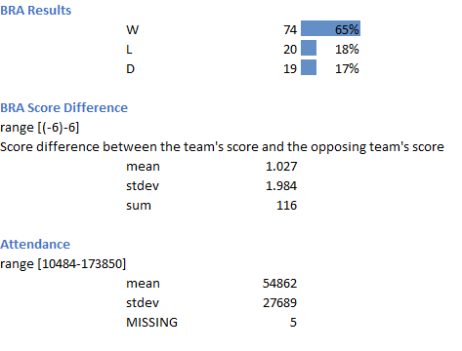
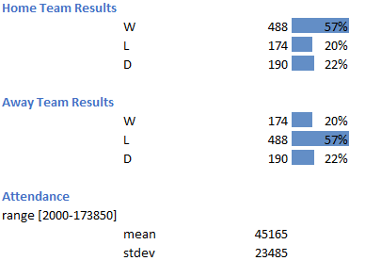
Codebook Sample
World Cup Dataset Codebook
Individual Team Dataset Codebook

Slide 4
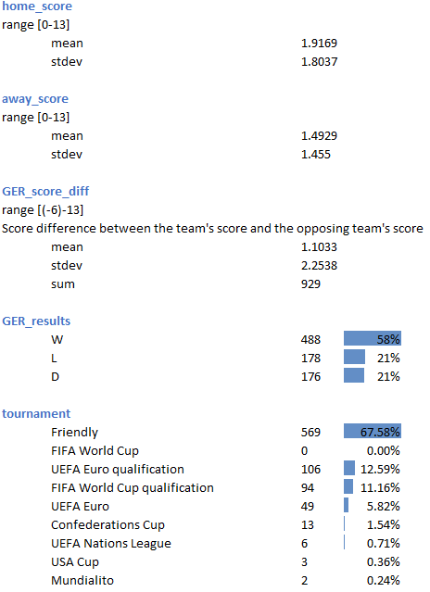
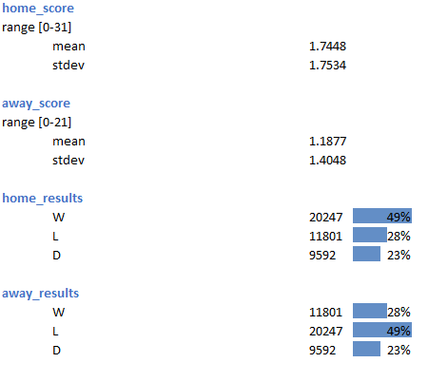
Codebook Sample (cont.)
Individual Team’s International Matches Dataset Codebook
International Matches Dataset Codebook

Slide 5
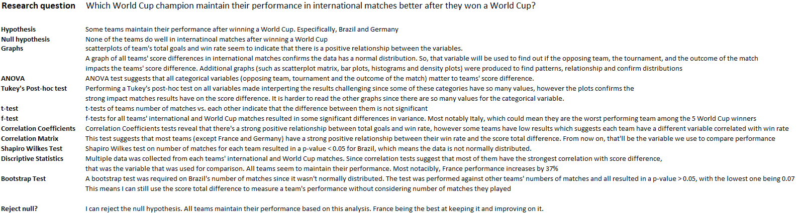
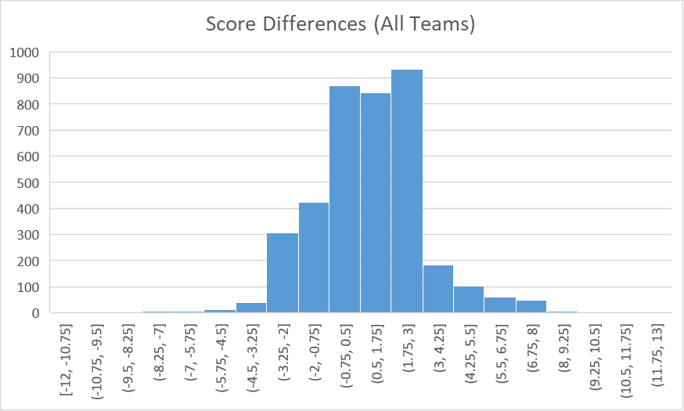
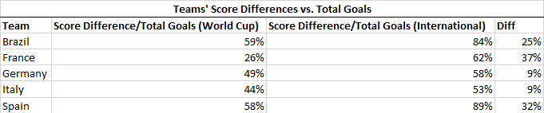

Slide 6
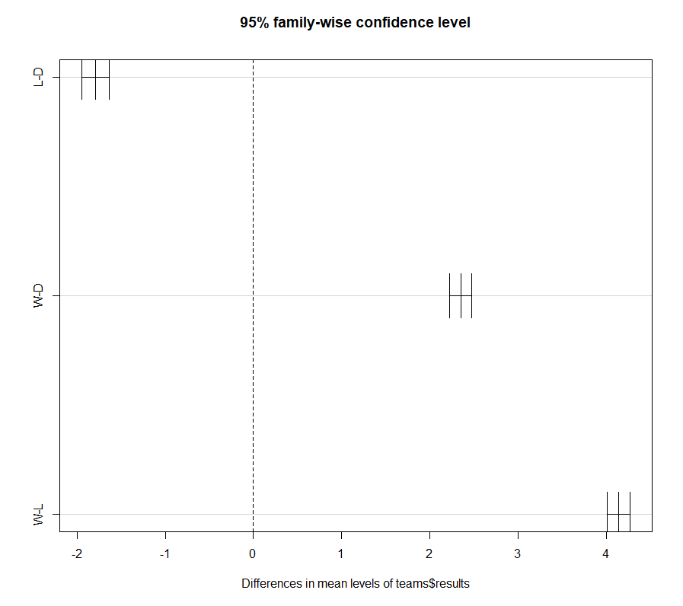
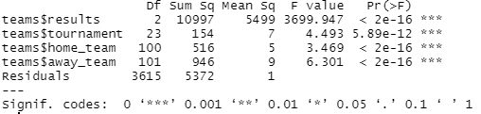
Research Question 1 Analysis (cont.)
Tukey’s post-hoc test plot
Score difference vs. match result
ANOVA test
Independent variable: score differences dependent: opposing team (home or away), tournament, match result

Slide 7
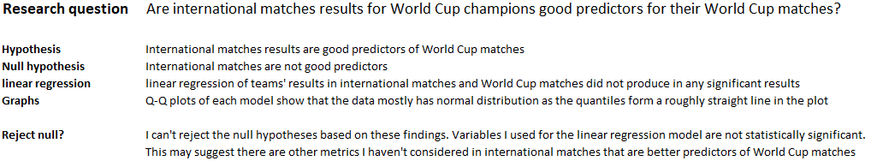
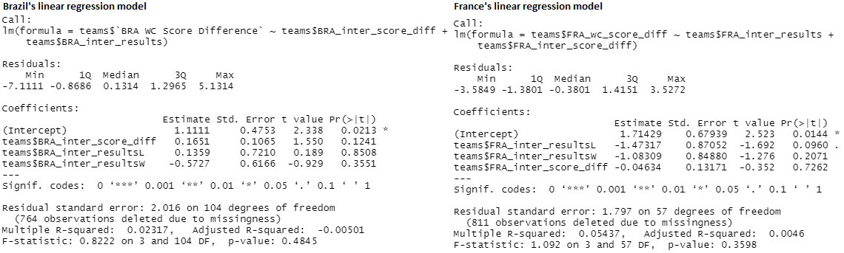

Slide 8
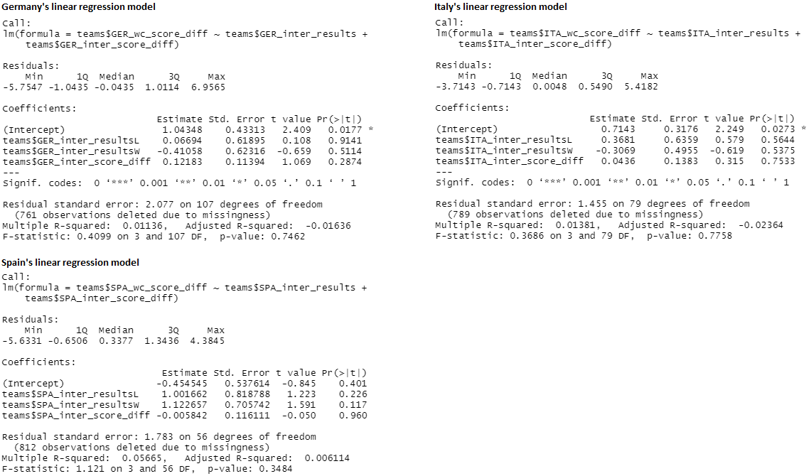
Research Question 2 Analysis (cont.)

Slide 9
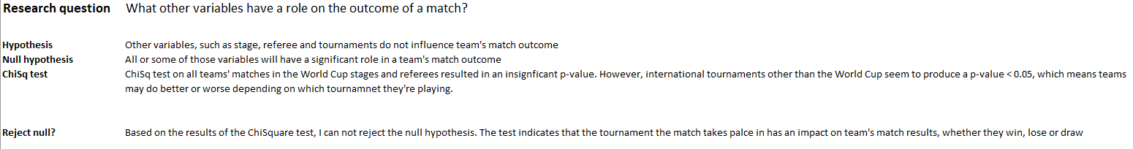
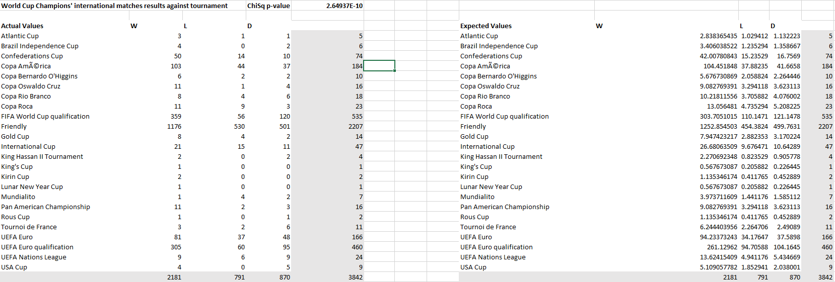

Slide 10
Summary of Results
Score difference between away and home teams matters, as it was confirmed by many tests. Therefore, it can be used as a measure for their performance in World Cup matches and international matches. And as descriptive statistics show, teams that won the World Cup in the last 20 years did indeed maintain their strong performance in the years following the World Cup they won.
While there was a connection between World Cup matches and international in terms of performance, further analysis showed that international matches can not be used to predict a team’s outcome in the World Cup, at least not with the variables I have in the datasets. That includes the team’s totals score difference. Which, as discussed earlier, was a good indicator of teams’ performance.
Finally, (and to my surprise), it appears that the tournament the match takes place in does in fact matter to the outcome of the match. That means for the observed teams: Brazil, France, Germany, Italy, and Spain (winners of World Cups in the last 20 years), they may perform better\worse depending on which tournament (other than the World Cup) they take part in. Other variables (such as referee and stage) do not have an impact on teams match outcome.

Slide 11
Bootstrap Code
library(readxl)brazil = read_excel("C:\\Users\\Yazee\\OneDrive\\Desktop\\brazil.xlsx")
n = length(brazil$Team...1)
B = 10000
BRAvsFRA = abs(mean(brazil$`Matches Played`[brazil$Team...2 == "Brazil"]) - mean(brazil$`Matches Played`[brazil$Team...2 == "France"]))
BRAvsGER = abs(mean(brazil$`Matches Played`[brazil$Team...2 == "Brazil"]) - mean(brazil$`Matches Played`[brazil$Team...2 == "Germany"]))
BRAvsITA = abs(mean(brazil$`Matches Played`[brazil$Team...2 == "Brazil"]) - mean(brazil$`Matches Played`[brazil$Team...2 == "Italy"]))
BRAvsSPA = abs(mean(brazil$`Matches Played`[brazil$Team...2 == "Brazil"]) - mean(brazil$`Matches Played`[brazil$Team...2 == "Spain"]))
BRAvsFRABRAvsGERBRAvsITABRAvsSPABootviews = matrix(sample(brazil$`Matches Played`, size=n*B, replace=TRUE), nrow=n, ncol=B)
Bootviews = matrix(sample(brazil$`Matches Played`, size=n*B, replace=TRUE), nrow=n, ncol=B)
boot.test.FRA = rep(0, B)
boot_FRA = matrix(sample(c(brazil$`Matches Played`[brazil$Team...2 == "Brazil"], brazil$`Matches Played`[brazil$Team...2 == "France"]), size=n*B, replace=TRUE), nrow=length(c(brazil$`Matches Played`[brazil$Team...2 == "Brazil"], brazil$`Matches Played`[brazil$Team...2 == "France"])), ncol=B)
boot_GER =matrix(sample(c(brazil$`Matches Played`[brazil$Team...2 == "Brazil"], brazil$`Matches Played`[brazil$Team...2 == "Germany"]), size=n*B, replace=TRUE), nrow=length(c(brazil$`Matches Played`[brazil$Team...2 == "Brazil"], brazil$`Matches Played`[brazil$Team...2 == "Germany"])), ncol=B)
boot_ITA = matrix(sample(c(brazil$`Matches Played`[brazil$Team...2 == "Brazil"], brazil$`Matches Played`[brazil$Team...2 == "Italy"]), size=n*B, replace=TRUE), nrow=length(c(brazil$`Matches Played`[brazil$Team...2 == "Brazil"], brazil$`Matches Played`[brazil$Team...2 == "Italy"])), ncol=B)
boot_SPA = matrix(sample(c(brazil$`Matches Played`[brazil$Team...2 == "Brazil"], brazil$`Matches Played`[brazil$Team...2 == "Spain"]), size=n*B, replace=TRUE), nrow=length(c(brazil$`Matches Played`[brazil$Team...2 == "Brazil"], brazil$`Matches Played`[brazil$Team...2 == "Spain"])), ncol=B)
for(i in 1:B){boot.test.FRA[i] = abs(mean(boot_FRA[1:5,i]) - mean(boot_FRA[5:13,i]))}
boot.test.GER = rep(0, B)
boot.test.ITA = rep(0, B)
boot.test.SPA = rep(0, B
)for(i in 1:B){boot.test.GER[i] = abs(mean(boot_GER[1:5,i]) - mean(boot_GER[5:10,i]))}
for(i in 1:B){boot.test.ITA[i] = abs(mean(boot_ITA[1:5,i]) - mean(boot_ITA[5:10,i]))}
for(i in 1:B){boot.test.SPA[i] = abs(mean(boot_SPA[1:5,i]) - mean(boot_SPA[5:10,i]))}
mean(boot.test.FRA >= BRAvsFRA)
mean(boot.test.GER >= BRAvsGER)
mean(boot.test.ITA >= BRAvsITA)
mean(boot.test.SPA >= BRAvsSPA)
FRA_means = rep(0, B)
GER_means = rep(0, B)
ITA_means = rep(0, B)
SPA_means = rep(0, B)
for(i in 1:B){FRA_means[i] = mean(boot_FRA[,i])}
for(i in 1:B){GER_means[i] = mean(boot_GER[,i])}
for(i in 1:B){ITA_means[i] = mean(boot_ITA[,i])}
for(i in 1:B){SPA_means[i] = mean(boot_SPA[,i])}
hist(FRA_means)hist(BRA_means)
hist(GER_means)hist(ITA_means)
hist(SPA_means)
ci_FRA = c(mean(FRA_means) - 1.96 * sd(FRA_means),mean(FRA_means), mean(FRA_means) + sd(FRA_means) * 1.96)
ci_GER = c(mean(GER_means) - 1.96 * sd(GER_means),mean(GER_means), mean(GER_means) + sd(GER_means) * 1.96)
ci_ITA = c(mean(ITA_means) - 1.96 * sd(ITA_means),mean(ITA_means), mean(ITA_means) + sd(ITA_means) * 1.96)
ci_SPA = c(mean(SPA_means) - 1.96 * sd(SPA_means),mean(SPA_means), mean(SPA_means) + sd(SPA_means) * 1.96)
ci_FRA
ci_GER
ci_ITA
ci_SPA

Slide 12
Linear Regression Code
library(readxl)
teams = read_excel("C:\\Users\\Yazee\\OneDrive\\Desktop\\314\\teams.xlsx")
BRA_lm = lm(teams$`BRA WC Score Difference` ~ teams$BRA_inter_score_diff + teams$BRA_inter_results)
FRA_lm = lm(teams$FRA_wc_score_diff ~ teams$FRA_inter_results + teams$FRA_inter_score_diff)
GER_lm = lm(teams$GER_wc_score_diff ~ teams$GER_inter_results + teams$GER_inter_score_diff)
ITA_lm = lm(teams$ITA_wc_score_diff ~ teams$ITA_inter_results + teams$ITA_inter_score_diff)
SPA_lm = lm(teams$SPA_wc_score_diff ~ teams$SPA_inter_results + teams$SPA_inter_score_diff)
summary(BRA_lm)
summary(FRA_lm)
summary(GER_lm)
summary(ITA_lm)
summary(SPA_lm)

